Slide 1
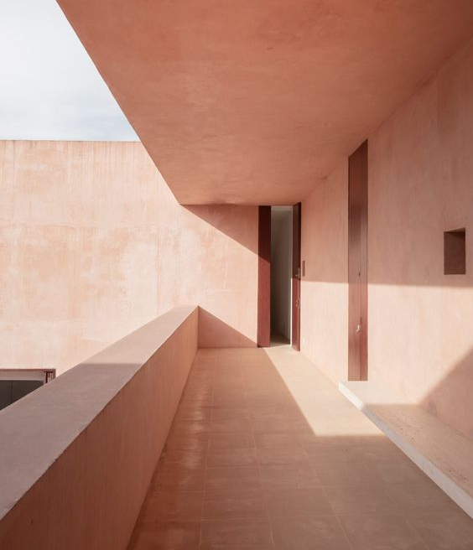
Neuendorf House
Massimo loverso
S8094455

Slide 2
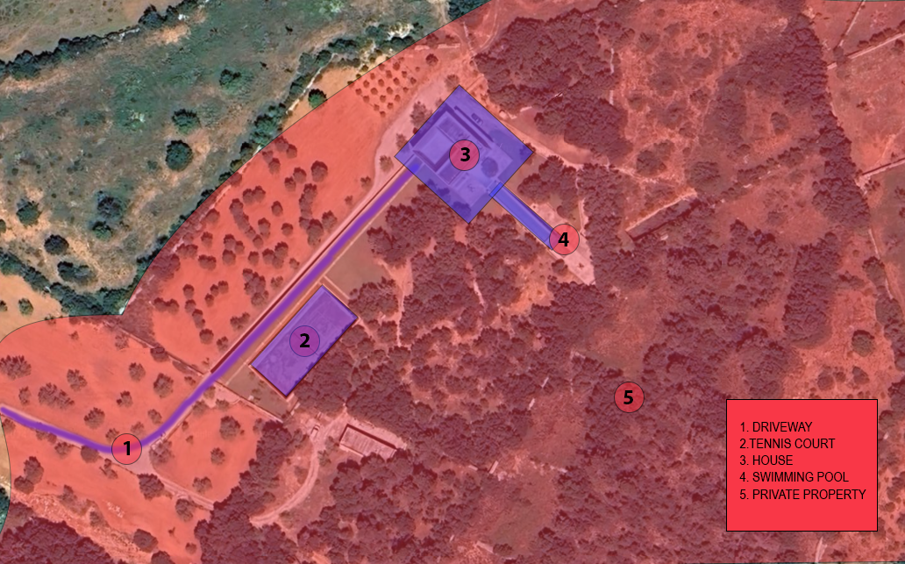
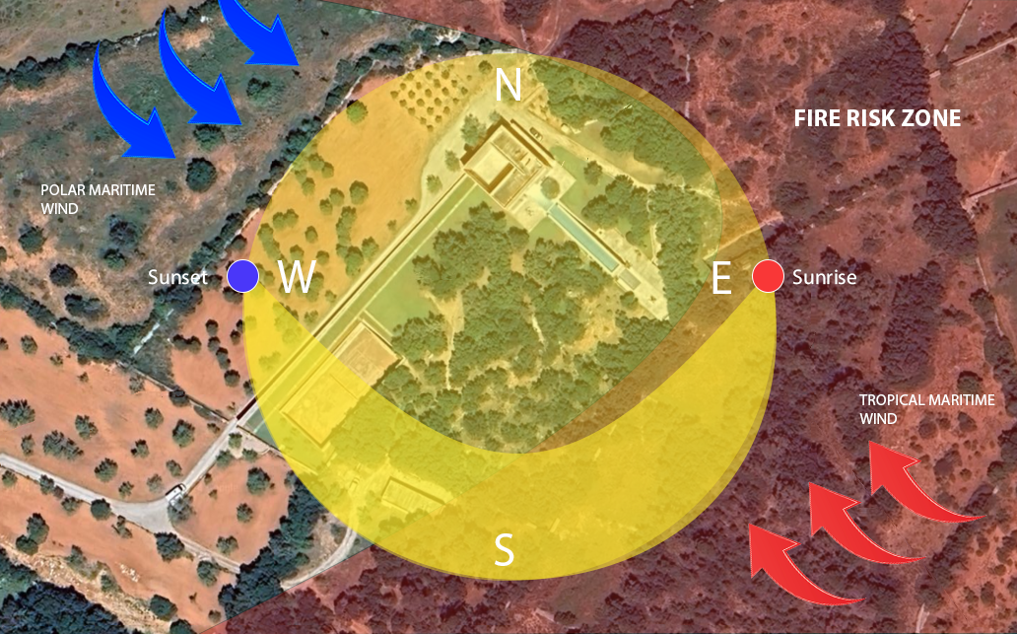
Site Analysis
The Neuendorf house is located in Mallorca Spain. The house is situated along a private road , surrounded by a large density of trees on a large block of land.
Mallorca experiences a year-round variety of weather due to its climate. A combination of Mediterranean and various air masses, such as subtropical marine, continental, and polar influences.

Slide 3
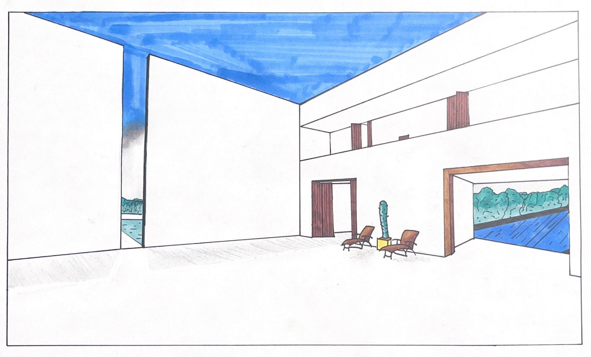
Perspective drawing

Slide 4
Model Takeoff notes
Materials
Plan
Process
Product | Quality | Cost
Boyles Clear Craft Glue | 1 | $9.49
Flat brown Carboard | 8 | $0 (From Work)
A1 Foam Board 5mm | 1 | $9.54
Deciduous Trees 38mm | 4 | $18.99
Stanley Knife | 1 | $0 (already owned)
Texters | - | $0 (already owned)
Ruler | - | $0 (already owned)
Pencils | - | $0 (already owned)
Cut brown Carboard to shape of topography for base.
Glue the layers of carboard onto each other
Using Stanley knife Cut Pannels from Foam board of each section of the house
Assemble using clear craft glue
Use texters to outline key features, pool and tennis court
TSA: Actions may very when process is being undergone.
 | Date | Status
Materials collected | 28/03/2024 | complete
Base has been created | - | -
House panels have been cut out | - | -
Glueing process | - | -

Slide 5
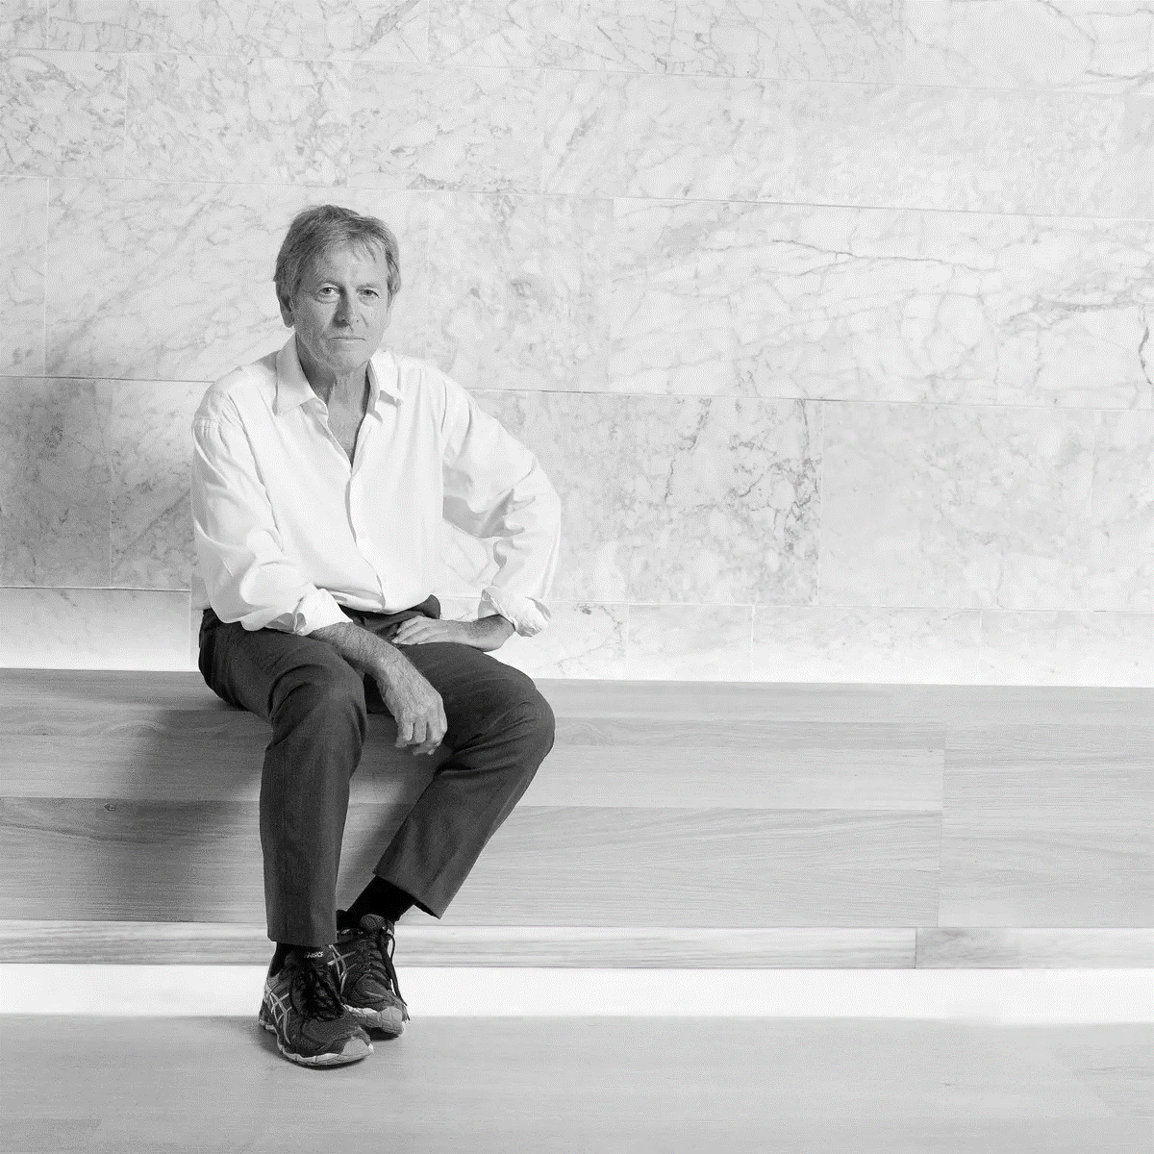
Group Theme (John Pawson, minimalism)
Complexity of minimalism
Our group chose John Pawson and minimalism, in particular I was inspired by the elegance of his well-known projects, Neuendorf House. Pawson's thinking of simplicity is demonstrated in his design. The Neuendorf House along with many other projects inspired our desire to follow his aesthetically pleasing and functional designs. Minimalism offers clarity with space, By using Pawson's minimalist aesthetic, we want to recreate these spaces that are not only visually stunning but also meaningful and beneficial to the human experience.
Figure 1.4: (N.d.). Retrieved from https://i.guim.co.uk/img/media/9a781c432346b407d6b1d70bcc190de0f2cb3d08/0_428_5039_3024/master/5039.jpg?width=1200&height=1200&quality=85&auto=format&fit=crop&s=8ddabf4ecef36525f386000e135b53d5

Slide 6
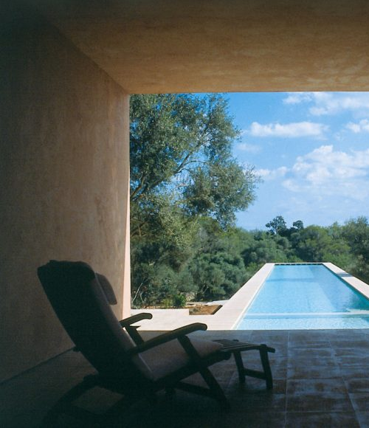
Part 2
Massimo loverso
S8094455

Slide 7
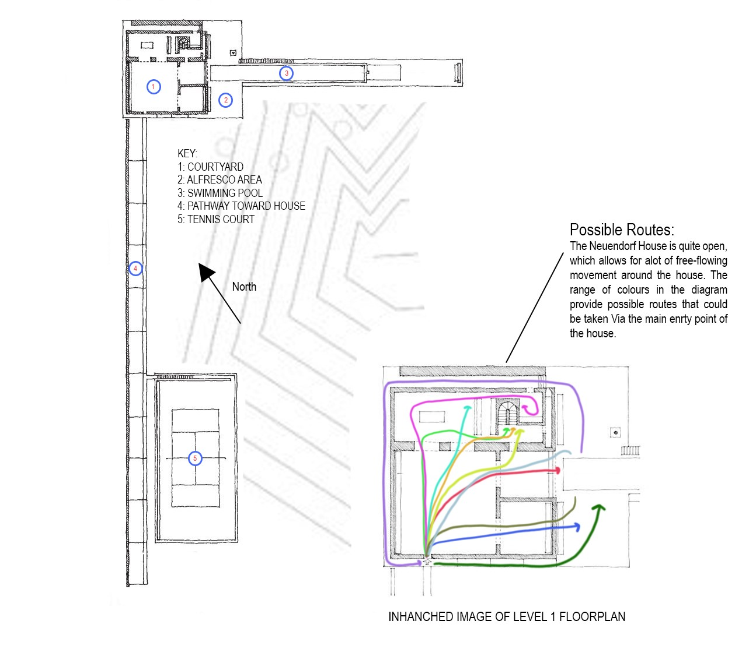
Site Analysis – Floor Plan
1: Courtyard
Provides a wide-open space, with high surrounding walls, and not a lot of furniture. The space can hold a large amount of people for special occasions.
2: Alfresco Area
Overlooks the dense tree line, rolling off the swimming pool. Again, quite empty to allow for focus on the simplistic beauty.
3.Swimming Pool
A large lap style swimming pool, the elevated pool provides a visible separation for the landscape.
4:Pathway Toward House
Lined with clean lines and minimal landscaping, it creates a sense of anticipation upon arrival, guiding visitors towards the sleek entrance of a narrow walkway
5:Tennis Court
The tennis court offers a perfect balance between functionality and aesthetic appeal. Set against the backdrop of the surrounding landscape, with a smooth playing surface and surrounding tall fences.

Slide 8
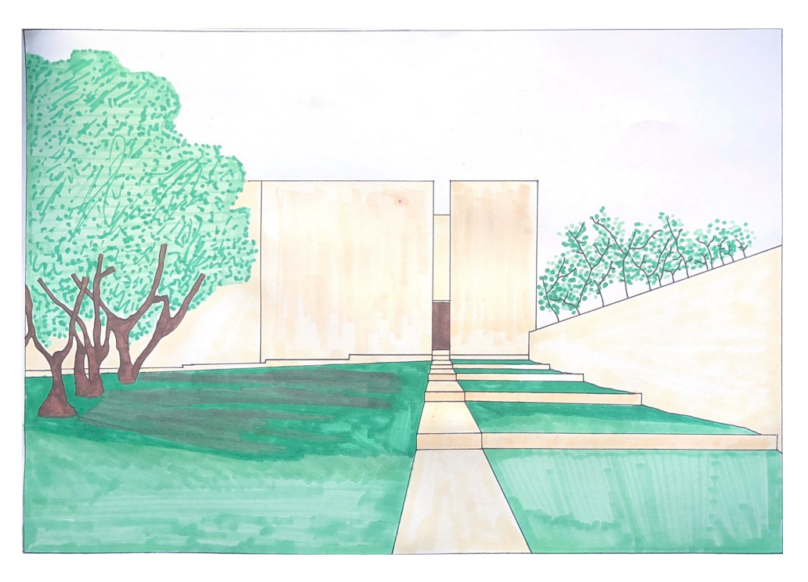
Perspective drawing

Slide 9
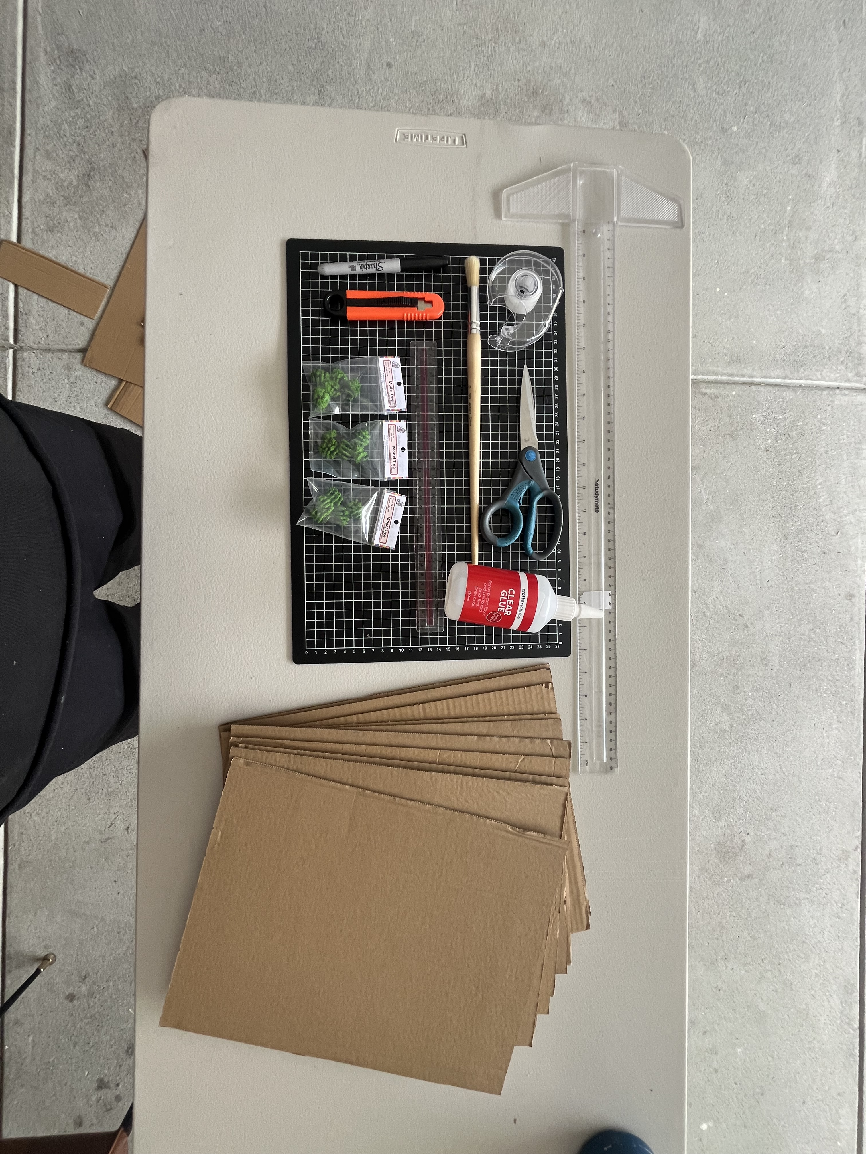
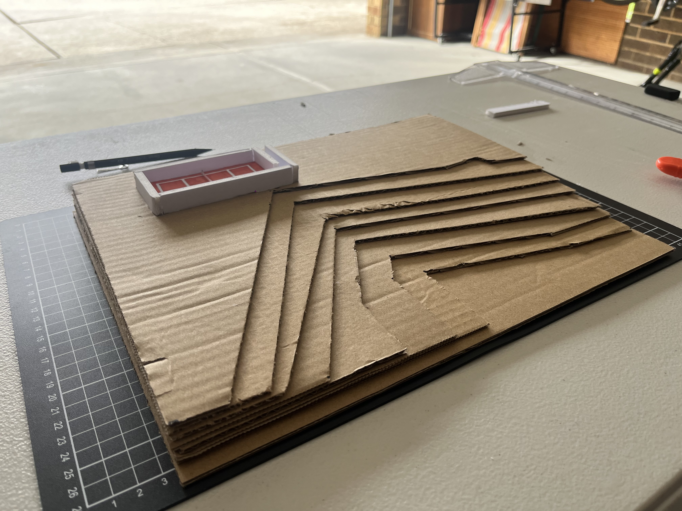
Model Takeoff notes
Action
Process
 | Date | Status
Materials collected | 28/03/2024 | complete
Base has been created | 6/04/2024 | complete
House panels have been cut out | - | -
Glueing process | - | -
Gather all materials to assemble model
Cut Carboard for the Topography
Glue all the carboard together to form the layers

Slide 10
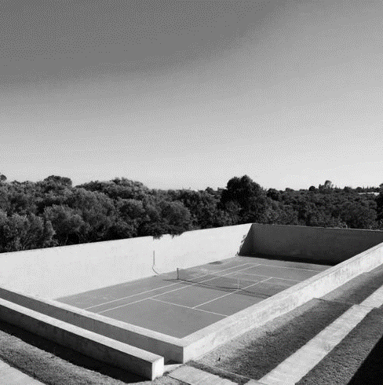
Group Theme (John Pawson, minimalism)
Complexity of minimalism
The aesthetic of the Neuendorf House resonates deeply with me, a personal aspiration has drawn me to create spaces that seamlessly blend visually. Opting for the floor plan for my site analysis allowed me to gain a deeper understanding of how pathways and interconnected spaces contribute to the overall flow and functionality of the Neuendorf House. This process offered insights into Pawson's thoughtful design decisions, informing my own understanding of design in a meaningful way. Exploring the pathways within the Neuendorf House unveiled an intention behind its architectural layout. The seamless addition of indoor and outdoor spaces, guided by thoughtfully planned pathways, reflects Pawson's vision of a perfect relationship between the built environment and nature. These pathways not only facilitate movement but also encourage exploration and contemplation. The minimalist design not only highlights the natural beauty of the landscape but also ensures the provision of functional living spaces that promote well-being.
Figure 2.4: The Neuendorf House – The Neuendorf House by architects Claudio Silvestrin and John Pawson. Clay tennis court: John pawson, Mallorca, Villa. (2019). Retrieved from https://dk.pinterest.com/pin/333970128618055281/

